Slide 1

Ionospheric Total Free-Electron Content(TEC) anomaly ⎯earthquake precursor
Jiangwei Wang

Slide 2
TEC Characters
The amount of TEC varies with the amount of radiation received from the Sun.
Seasonal variations, less radiation received from the Sun in winter, more in summer.
Strong Daily fluctuations, high tec value during daytime and near-zero tec at night-time
imposes a dispersive delay on the GPS satellite ranging signals broadcasting
Affection on signals varies with TEC values

Slide 3

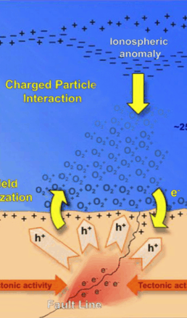
Relationship between earthquake and tec
During earthquake preparation, free-electrons are released and change the local ionospheric tec
Tec anomaly time remain controversial, between 3 days and 2 weeks before and after the earthquake are discussed in different researches

Slide 4
goals
Build a program for Pre-earthquake TEC anomaly (PETA) visualization analysis by using GPS Toolkit (GPSTk).
Employ deep learning method, to recognize the underlying relationships between ionospheric TEC anomaly and earthquakes.

Slide 5
Raw data
Receiver Independent Exchange Format (RINEX)
enable users to post-process the GPS stations received data and generating more accurate results.
Observation data from Geonet
e.g. yald2430.19o, contains all the related physical quantity observations in a 30 seconds intervals.
e.g. yald2430.19d, Hatanaka compressed file, 35% file size compression capability.
Navigation data from Scripps Orbit and Permanent Array Center(SOPAC)
Eeg. auto2430.19n, broadcast ephemeris data for the GPS constellation

Slide 6
Data ethics
geonet
GeoNet project sponsors request to be acknowledged for all users that are using the data.
GeoNet project sponsors are not liable for any loss and damage resulting from the use of the data directly or indirectly.
GeoNet project sponsors can’t guarantee data accuracy, completeness, and fitness for all-purpose use (“Geonet”).
sopac
“Please acknowledge usage of SOPAC data and/or data products in your publications, applications and products. Access to the SOPAC archive is intended for non-commercial users but there are no user fees and there is significant usage by the private sector (“sopac”).”

Slide 7
Gps toolkit (gpstk)
an open-source computing suite to the satellite navigation community produced by Space and Geophysics Laboratory within the Applied Research Laboratories of the University of Texas at Austin, to process GPS associated satellite navigation system data.
enable us to compute TECU in the ionosphere by following programs.
“ResCor”
“IonoBias”
“TECMaps”
All applications are created by using ISO-standard C++ programming language, to ensure that the code is modular, extensible, and maintainable

Slide 9
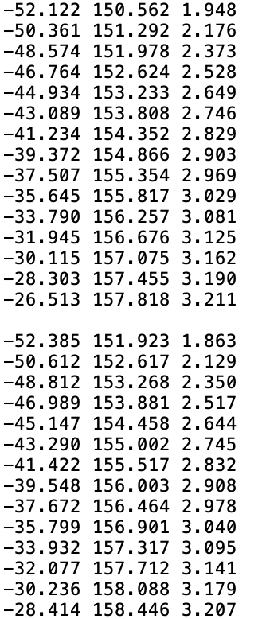
“tecmaps”
All outputs from “rescor” and ‘IONObias’ are fed in, to estimate the ionospheric TEC on each point of a horizon grid at a fixed height of 350 kilometres.
It computes the average VTEC value at each time point first, then executes a double loop, over all grid points and all data values, to compute each grid value.
The output from “TECMaps” is 2881 files, 2880 are the estimated TEC values of each grid with corresponding latitudes and longitudes. Each of the 2880 files is one of the 30 seconds time intervals TEC values throughout the 24 hours range.

Slide 10
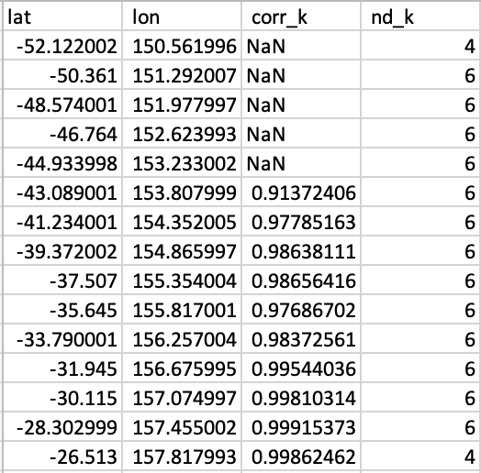
Anomaly correlation
There is 1 correlation file per day.
it compares each grid’s TECU values to neighbour grids spatially and temporally.
If one or fewer grids’ TECU are different from neighbours, there is more likely to be a PETA.
If TECU are standing out from their neighbour grids in a large area, this is more likely caused by solar activities or other geomagnetic effects.
closer to 0 showing a strong correlation.

Slide 11

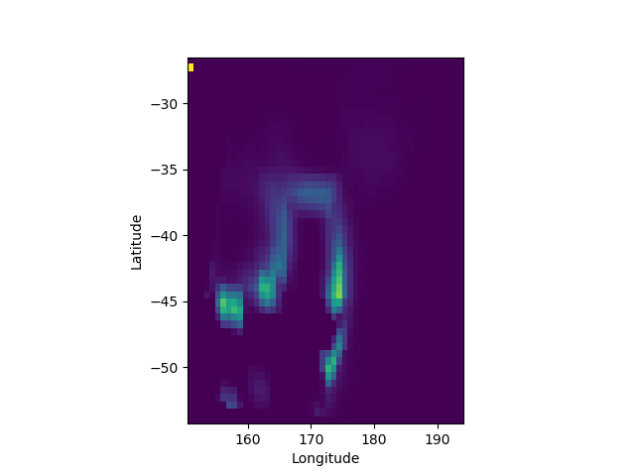
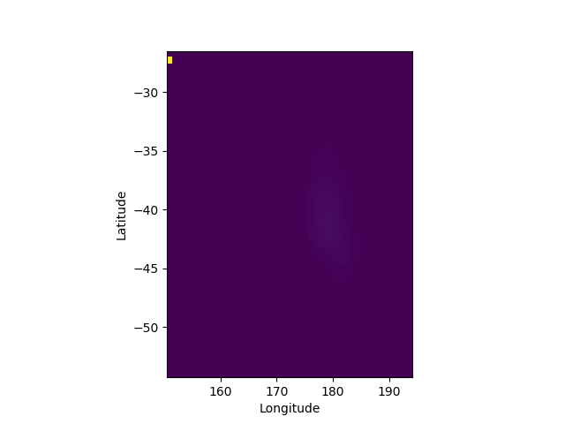
Correlation images

Slide 12
Deep learning
Learning Method: Convlstm2d from ‘tensorflow’.
learning data: new Zealand 29 major earthquakes from 2003 (exclude aftershocks within 3 days).
Output data: percentage to be an earthquake event.

Slide 13
data
Daily correlation IMAGEs (50, 50, 1) SHAPED NUMPY ARRAY data.
Centre and scaled sunspot numbers.
Centre and scaled day of the year.
24 IMAGES each event. 21 DAYS BEFORE THE EVENT, 2 DAYS AFTER.

Slide 14
DATA PREPARATION
26 events and 3 events data splitting
A TIME SEQUENCE LENGTH OF 10 DAYS IS APPLIED, 15 SEQUENCES EACH EVENT.
Data label list for each event is [0, 0, 0, 0, 0, 0, 0, 0, 0, 0, 0.05, 0.25, 0.4, 0.25, 0.05]
Training data Resampling
Training data shuffling

Slide 15
training
 | kernels | layers | neurons | shrinkage | target
trial 1 | 2.498 | 3.803 | 36.87 | 0.197 | 0.054
trial 2 | 1.624 | 0.624 | 3.846 | 0.732 | 0.05415
trial 3 | 3.404 | 2.832 | 2.009 | 0.94 | 0.05431
trial 4 | 4.33 | 0.8494 | 9.909 | 0.367 | 0.5449
trial 5 | 2.217 | 2.099 | 22.17 | 0.582 | 0.05437
trial 6 | 3.447 | 0.558 | 15.32 | 0.733 | 0.05441
trial 7 | 2.824 | 3.141 | 10.78 | 0.028 | 0.05448
trial 8 | 3.37 | 0.1858 | 30.77 | 0.341 | 0.05481
trial 9 | 1.26 | 3.796 | 48.32 | 0.617 | 0.05492
trial 10 | 2.218 | 0.3907 | 34.53 | 0.88 | 0.05482
trial 11 | 1.488 | 1.981 | 2.685 | 0.819 | 0.05474
trial 12 | 2.035 | 2.65 | 16.27 | 0.04 | 0.05484
trial 13 | 2.453 | 0.2091 | 34.59 | 0.872 | 0.05498
trial 14 | 2.942 | 0 | 34.44 | 0.245 | 0.05506
trial 15 | 3.573 | 0.1856 | 35.23 | 0.639 | 0.05526
trial 16 | 3.672 | 0 | 34.32 | 1 | 0.05534
trial 17 | 4.987 | 0.0214 | 34.07 | 0.956 | 0.05536
trial 18 | 4.646 | 1.431 | 34.25 | 0.038 | 0.05537
trial 19 | 5 | 0.9348 | 32.69 | 1 | 0.05561
trial 20 | 4.943 | 2.558 | 32.3 | 0.955 | 0.05565
Bayesian Optimizer
12 points grid search
8 iterations

Slide 16
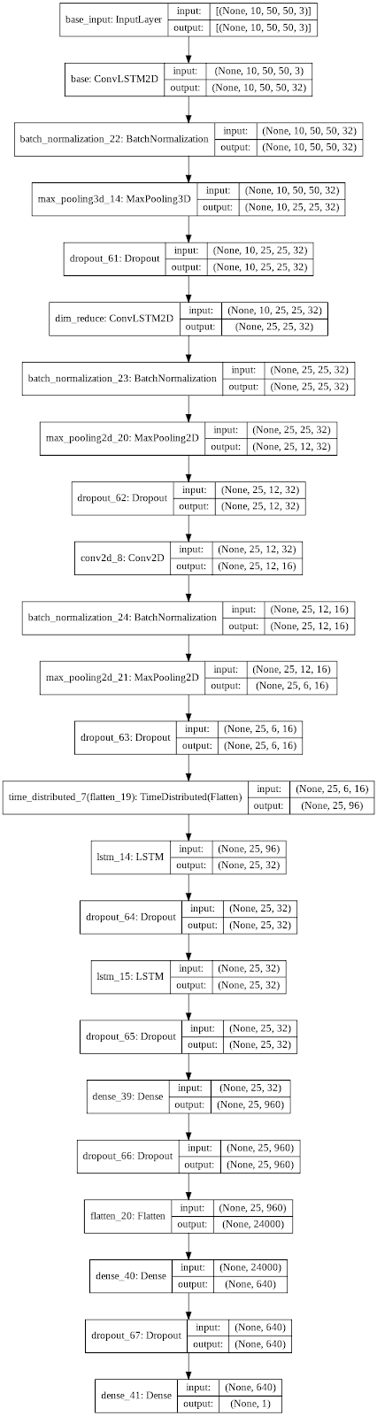
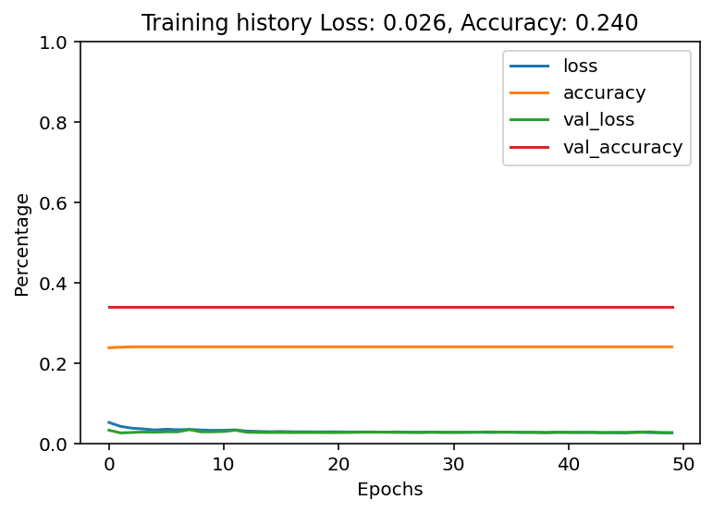

Slide 17
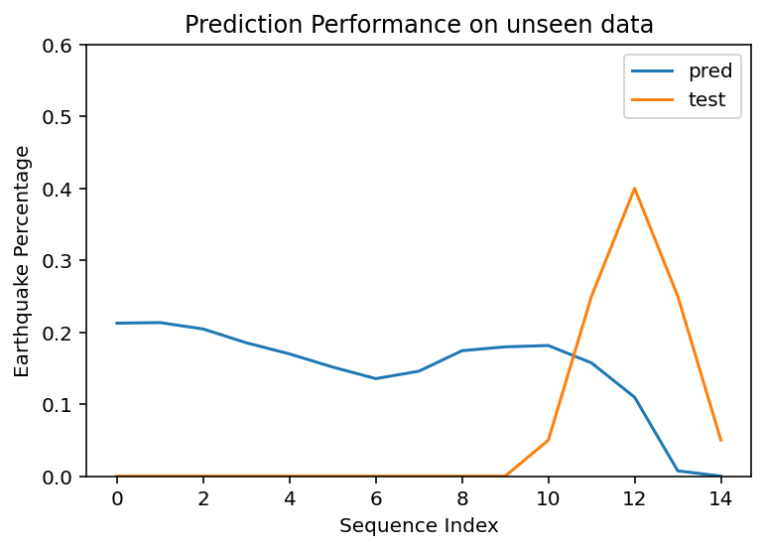
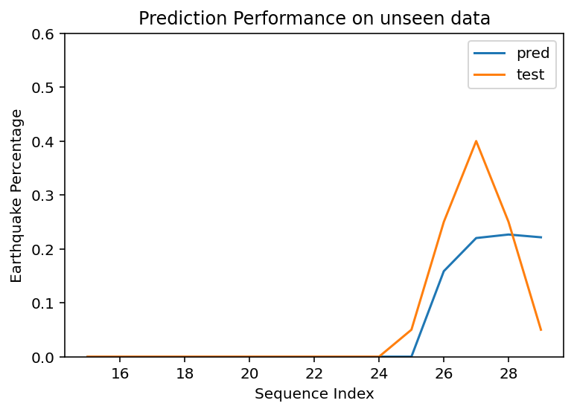
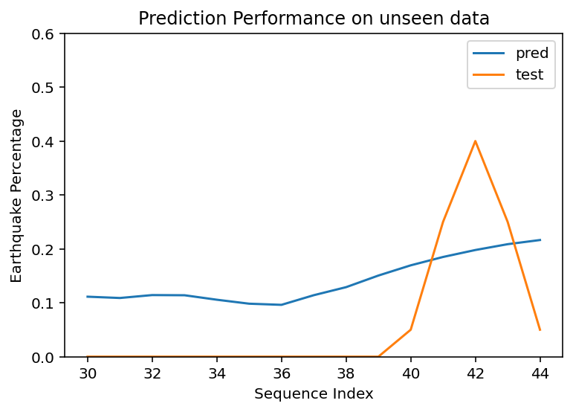
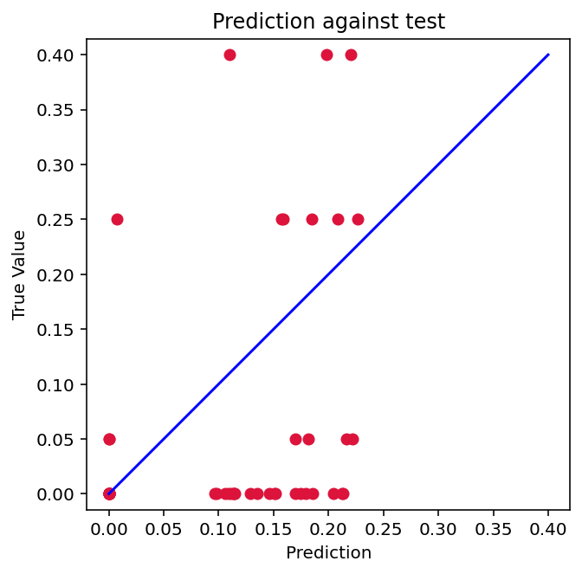
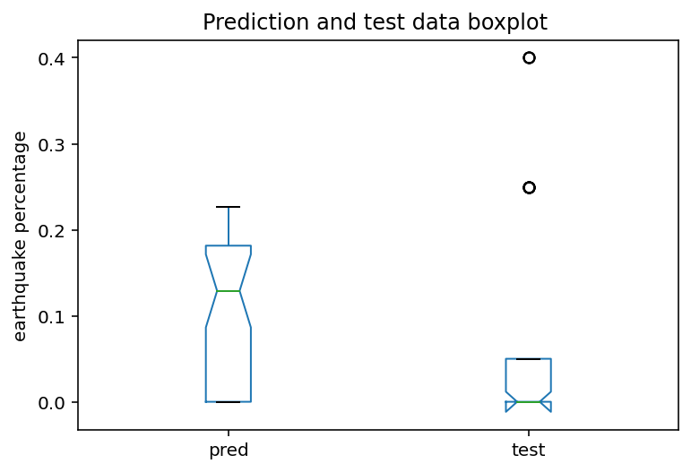

Slide 18
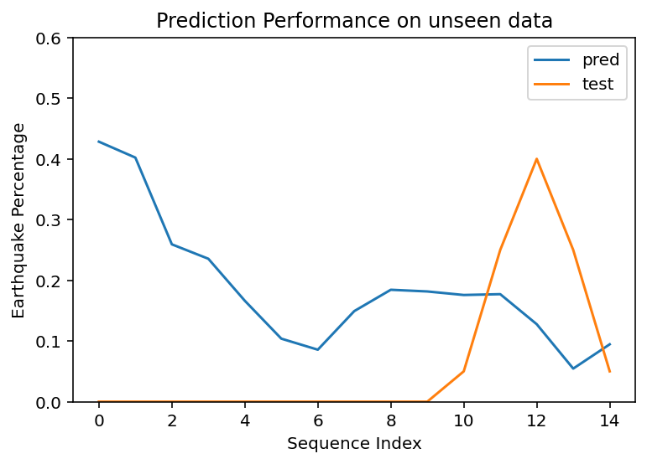
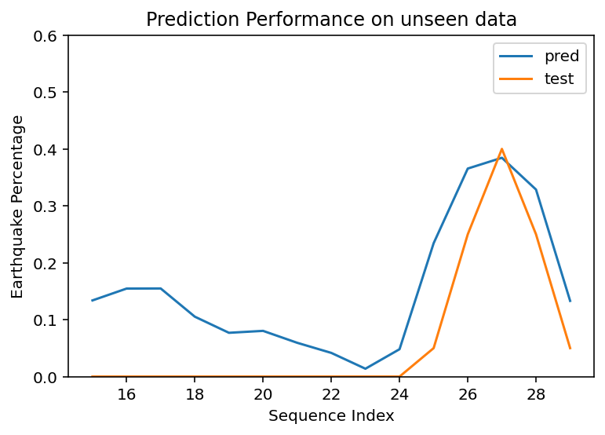
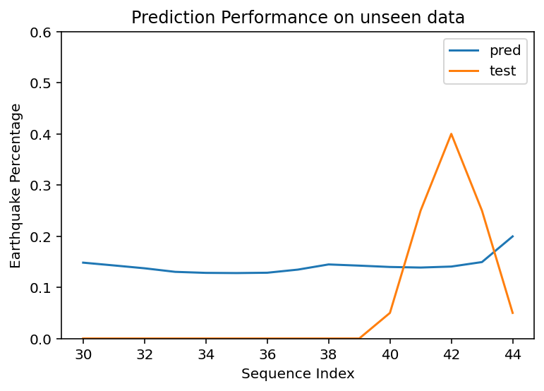
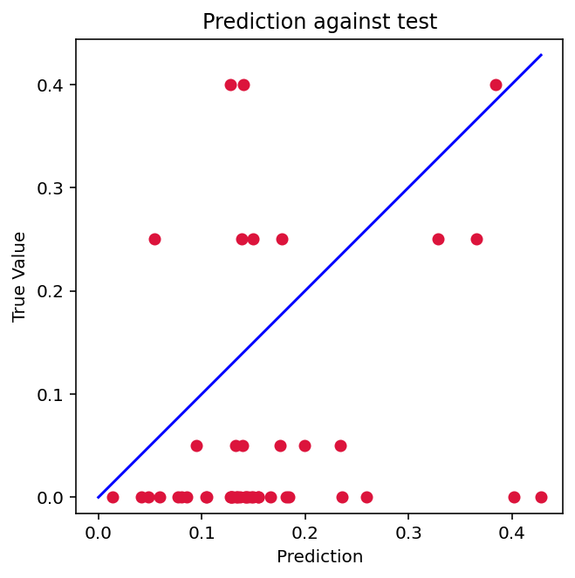
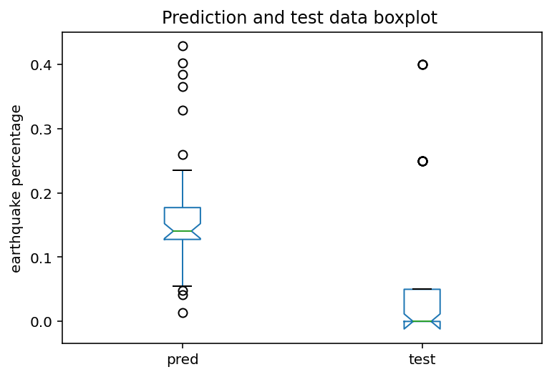

Slide 19
“no one does when they begin. Ideas don’t come out fully formed. They only become clear as you work on them. You just have to get started (Mark Zuckerberg).”

